Slide 1
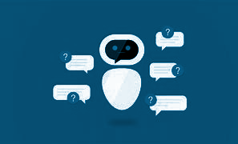
LIBRARY CHATBOT

Slide 2

BY:
K.J.BHASKER
R.INDUJA
R.KEERTHANA
M.MALINISRI
A.RAGAVENTHRAN
G.ROHITH
G.SWETHA
COIMBATORE INSTITUTE OF TECHNOLOGY

Slide 3

Summary
To avoid overcrowding in library by knowing the availability of books in an easy and quick manner a smart solution is made ,with the help of artificial intelligence and chatbots which can be used in library websites or in mobile app.

Slide 4




Main Characters
BHASKER.K.J
INDUJA.R
MALINISRI.M
RAGAVENTHRAN.A
Interfacing check engine and book recommendation.
Book recommendation engine and telebot interfacing.
Book recommendation engine and website interfacing.
Interfacing check engine and book recommendation.

Slide 5
Main Characters
SWETHA.G
KEERTHANA.R
ROHITH.G
Bug resolving and error finding
Dataset fetching and book recommendation engine
Auto correct and Telbot interfacing

Slide 6
Conflict
To provide an user friendly interface between the students and library for fetching the books and knowing availability of books.

Slide 7
Solution
An user friendly chatbot is made in the library website or in an social media to resolve this problem,by using ML and AI algorithms.

Slide 8




Book recommendation engine
Book check engine
Model
output/input
Telegram(social media)
Or websites

Slide 9
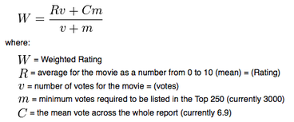
BOOK RECOMMENDATION ENGINE:
Datasets from goodreds.com
Reference from kaggle datasets and code
Cosine similarity algorithm
Outputs of first 5 neighbors books

Slide 10
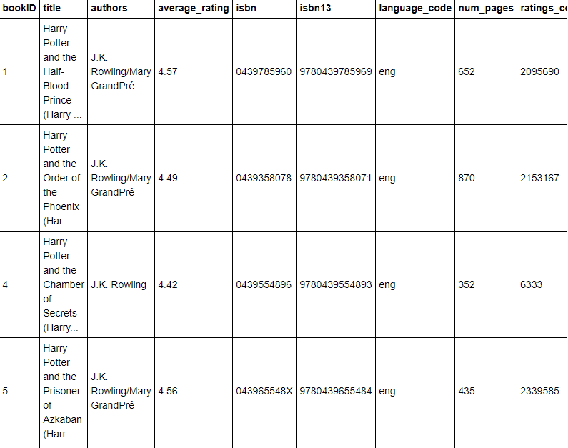
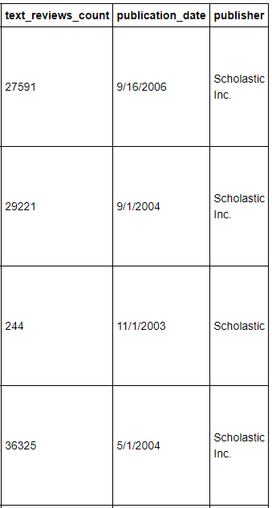
DATASET:

Slide 11
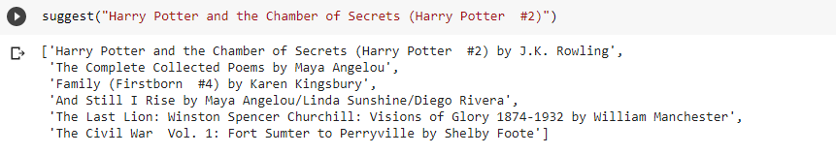
OUTPUT:

Slide 12
Book check engine:
It uses simple .csv searching algorithm.
We will get the rack number and availability status of the book in this function.
Dataset is modified slightly with extra columns.

Slide 13
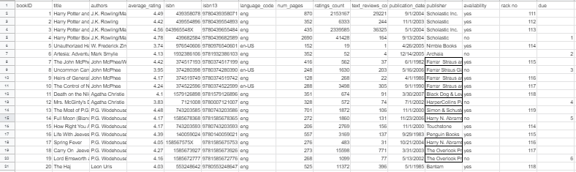
DATASET:

Slide 14
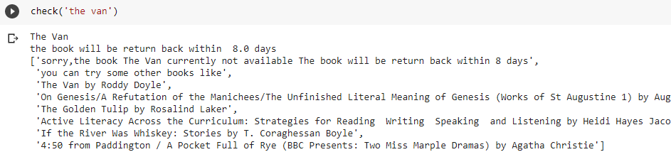
OUTPUT:

Slide 15
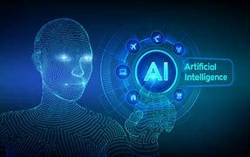
Model:
It consists of chatterbot corpus.
We used best match logic adapter.
The chatterbot is trained with prefix and books name with maximum threshold of 0.90 match.
The model also consists of autocorrect function.
According to the input the model get the datas from engines and process it.

Slide 16
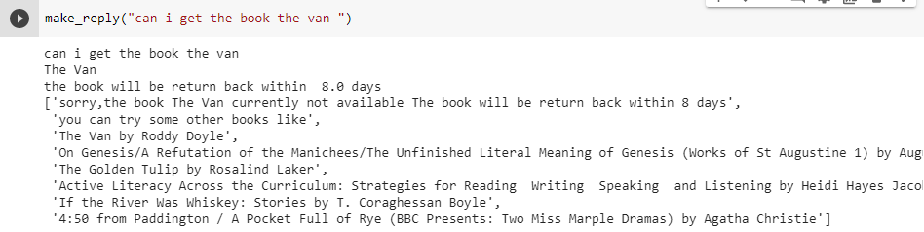
OUTPUT:

Slide 17
Here comes the output part!!
We use chatbots for our console

Slide 18
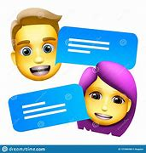
What is Chatbot?
Chatbots are the software application used for chat conversations via text or text to speech.
It provides user friendly environment for applications.
In our model chatbots are used for getting the information of the books.

Slide 19
Telebot:
We Created a telegram bot in telegram app with the use of botfather.
The API token of the bot is configured in the program to get and respond activities.
The bot is added in the group.
Now the informations are transferred through the bot in telegram(mobile app).
Note: (Bot Commands -A command must always start with the '/’symbol).

Slide 20
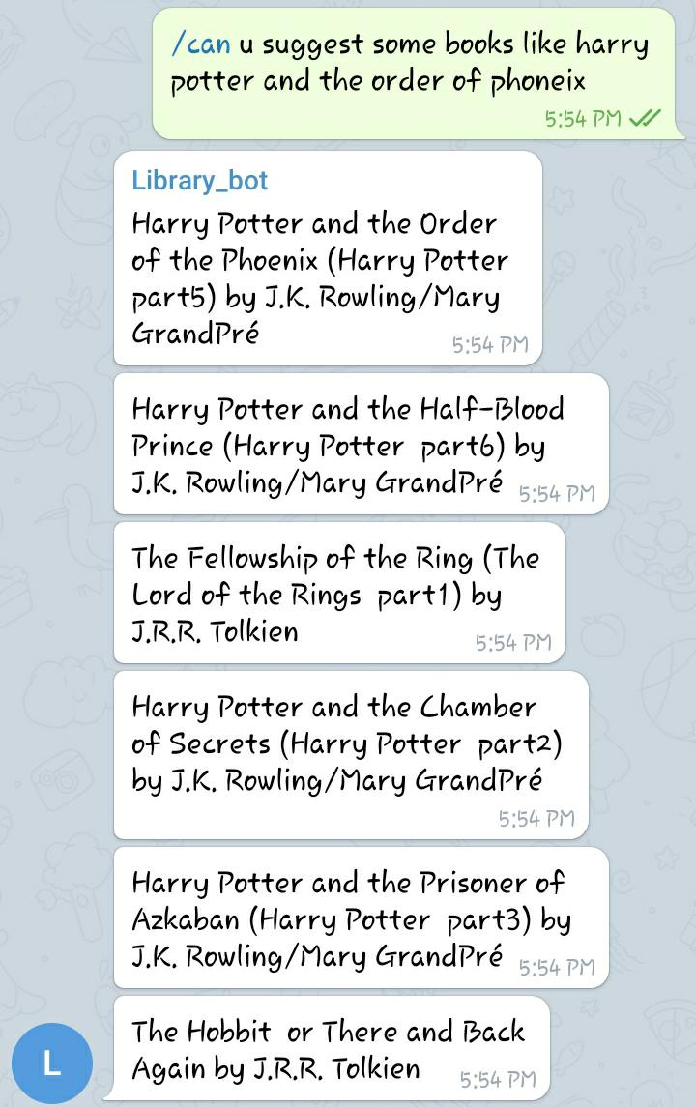

Outputs:

Slide 21
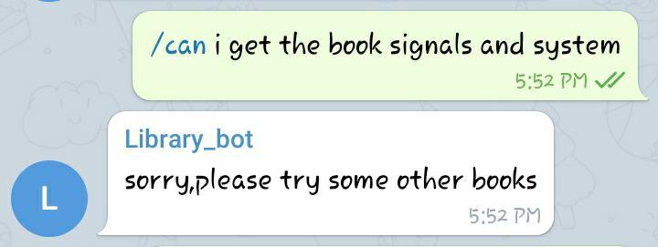
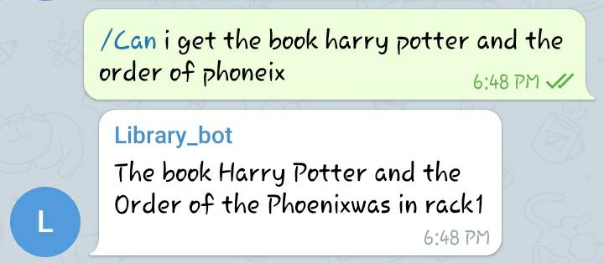


Slide 22
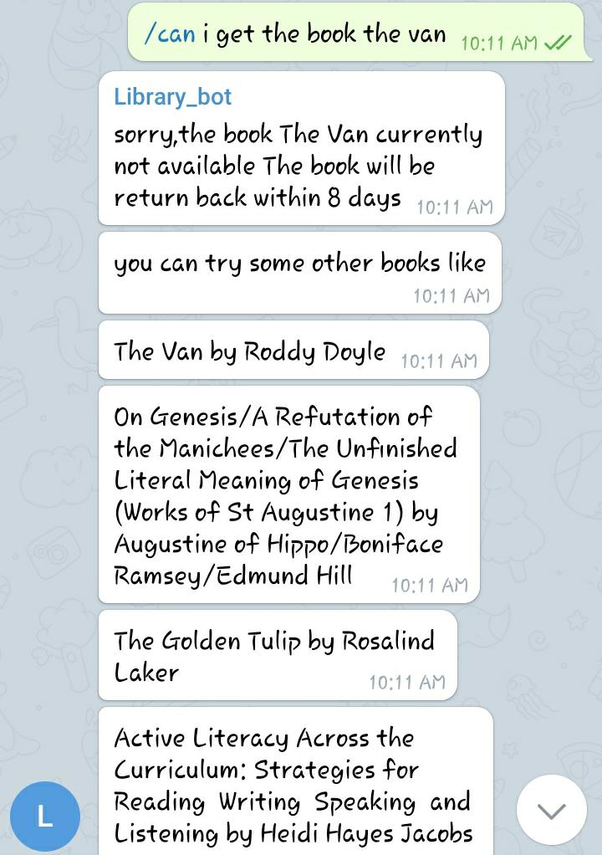


Slide 23
Website:
We also attached a chatbot in website,which act as library website for demo.
We created the website using flask libraries.
We referred "https://github.com/Arraxx/new-chatbot.git" fo creating chatbot in that website.
The website works in local host.

Slide 24
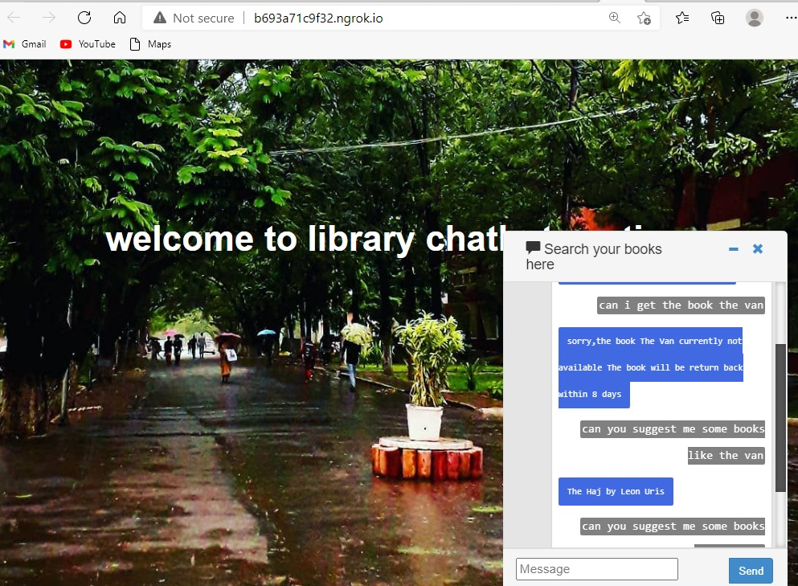
Output:

Slide 25

We developed this software using google colab
You can find this source code and readme doc in:Ragavan7071/library_chatbot (github.com) an github repo.

Slide 26
References:
Goodreads Book Datasets With User Rating 10M | Kaggle
Kaggle: Your Machine Learning and Data Science Community
Book Recommendation Engine | Kaggle
https://github.com/Arraxx/new-chatbot.git
Telegram Bot Platform
Flask Tutorial - Tutorialspoint
ChatterBot · PyPI
cristiandatum/DS_Response_Pipeline: Disaster Reponse Pipeline for Udacity Data Science nanodegree (github.com)

Slide 27
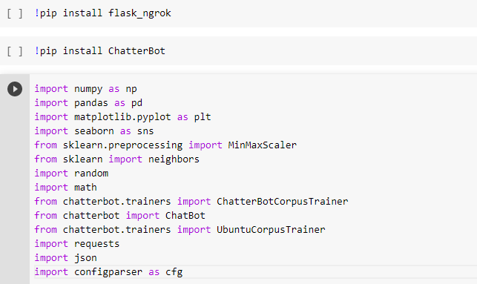
Tools imported:

Slide 28

Code explanation:

Slide 29


